Slide 1
ATTEND-IN Team Geo
eric Kelley, Steven Stewart, Nicole grizzle, hard Thakkar, Cameron Sumlin-eskridge,

Slide 2

Product
Attend-in is an android application that allows students to mark their attendance and allows professors to monitor attendance.
Uses the student's current location to ensure that they are present in class.
Records how long the student was in class and the time in which they arrived and left the class.

Slide 3
Value
Provides a simple and easy to use interface for student attendance.
Assists professors in keeping track of attendance and lessens the burden of having to monitor attendance themselves.
Prevents students from marking themselves present when they are not in the class.

Slide 4
Completed Stories
Create Test Scenarios
MD5 Hash setup
Professor Timer function
Attendance Database Layout
Cache First Time Login Data
Burndown Chart
Velocity Report

Slide 5
Backlog
Database-Timer Evaluation
Compare Timer and Hash
Connect Professor side with API

Slide 6
Test Scenario 1: The Professor can take the attendance for their class and can review the attendance
Case 1: Can the professor login to the app?
Case 2: Does the app store the professor’s login information?
Case 3: Can the professor create a timer for attendance?
Case 4: Does the app access the class database?
Case 5: Can the professor request the class attendance from the database?

Slide 7
Test Scenario 2: The student can mark their attendance using the app based on their current location
Case 1: Can the student enter their login credentials?
Case 2: Is the student login info cached?
Case 3: Is the student’s location monitored using the app?
Case 4: Can the student successfully login to a class?
Case 5: Does the app correctly set the timer created by the professor?

Slide 8
Test Scenario 3: The application frontend can communicate with the api and the database
Case 1: Does the frontend send the correct request to the backend api?
Case 2: Does the backend send a response back from the frontend request?
Case 3: Can the frontend read the response from the backend?
Case 4: Does the backend send the requested data in the correct format?
Case 5: Does the frontend respond correctly to errors regarding connecting to the backend?

Slide 9
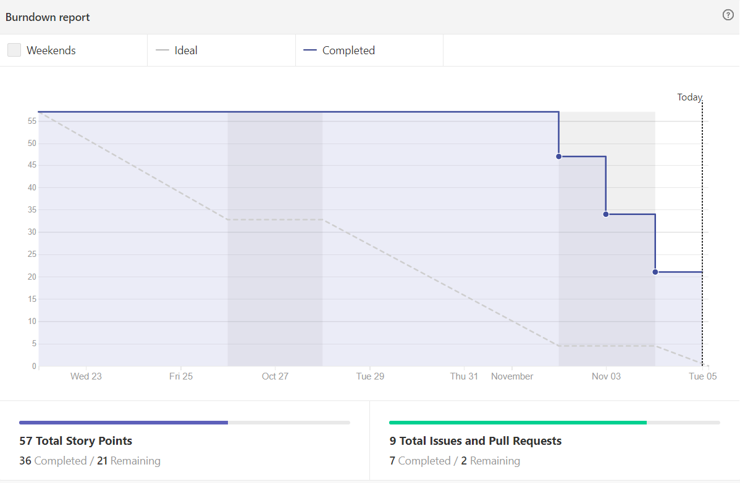
Burndown Chart

Slide 10
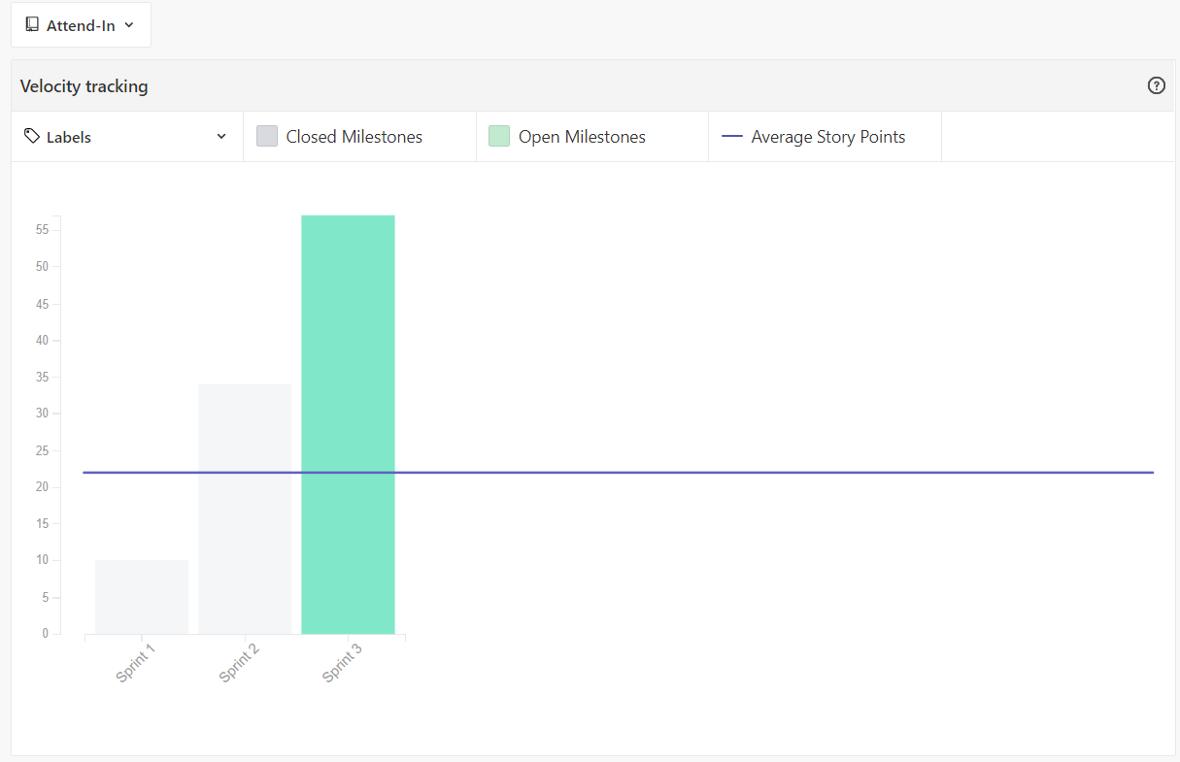
Velocity Chart

Slide 11
Questions?

Slide 12
Thank You!

